Slide 1

Chapter 2
Application Layer
A note on the use of these ppt slides:
We’re making these slides freely available to all (faculty, students, readers). They’re in PowerPoint form so you can add, modify, and delete slides (including this one) and slide content to suit your needs. They obviously represent a lot of work on our part. In return for use, we only ask the following:
If you use these slides (e.g., in a class) in substantially unaltered form, that you mention their source (after all, we’d like people to use our book!)
If you post any slides in substantially unaltered form on a www site, that you note that they are adapted from (or perhaps identical to) our slides, and note our copyright of this material.
Thanks and enjoy! JFK/KWR
All material copyright 1996-2007
J.F Kurose and K.W. Ross, All Rights Reserved
Computer Networking: A Top Down Approach,
4th edition.
Jim Kurose, Keith Ross
Addison-Wesley, July 2007.

Slide 2
Chapter 2: Application layer
2.1 Principles of network applications
2.2 Web and HTTP
2.3 FTP
2.4 Electronic Mail
  SMTP, POP3, IMAP
2.5 DNS
2.6 P2P applications
2.7 Socket programming with TCP
2.8 Socket programming with UDP

Slide 3
Chapter 2: Application Layer
Our goals:
conceptual, implementation aspects of network application protocols
  transport-layer service models
  client-server paradigm
  peer-to-peer paradigm
learn about protocols by examining popular application-level protocols
  HTTP
  FTP
  SMTP / POP3 / IMAP
  DNS
programming network applications
  socket API

Slide 4
Some network apps
e-mail
web
instant messaging
remote login
P2P file sharing
multi-user network games
streaming stored video clips
voice over IP
real-time video conferencing
grid computing

Slide 5





Creating a network app
application
transport
network
data link
physical
write programs that
  run on (different) end systems
  communicate over network
  e.g., web server software communicates with browser software
No need to write software for network-core devices
  Network-core devices do not run user applications
  applications on end systems allows for rapid app development, propagation
application
transport
network
data link
physical
application
transport
network
data link
physical

Slide 6
Chapter 2: Application layer
2.1 Principles of network applications
2.2 Web and HTTP
2.3 FTP
2.4 Electronic Mail
  SMTP, POP3, IMAP
2.5 DNS
2.6 P2P applications
2.7 Socket programming with TCP
2.8 Socket programming with UDP
2.9 Building a Web server

Slide 7
Application architectures
Client-server
Peer-to-peer (P2P)
Hybrid of client-server and P2P

Slide 8
Client-server architecture
server:
  always-on host
  permanent IP address
  server farms for scaling
clients:
  communicate with server
  may be intermittently connected
  may have dynamic IP addresses
  do not communicate directly with each other
client/server

Slide 9
Pure P2P architecture
no always-on server
arbitrary end systems directly communicate
peers are intermittently connected and change IP addresses
Highly scalable but difficult to manage
peer-peer

Slide 10
Hybrid of client-server and P2P
Skype
  voice-over-IP P2P application
  centralized server: finding address of remote party:
  client-client connection: direct (not through server)
Instant messaging
  chatting between two users is P2P
  centralized service: client presence detection/location
    user registers its IP address with central server when it comes online
    user contacts central server to find IP addresses of buddies

Slide 11
Processes communicating
Process: program running within a host.
within same host, two processes communicate using inter-process communication (defined by OS).
processes in different hosts communicate by exchanging messages
Client process: process that initiates communication
Server process: process that waits to be contacted
Note: applications with P2P architectures have client processes & server processes

Slide 12
App-layer protocol defines
Types of messages exchanged,
  e.g., request, response
Message syntax:
  what fields in messages & how fields are delineated
Message semantics
  meaning of information in fields
Rules for when and how processes send & respond to messages
Public-domain protocols:
defined in RFCs
allows for interoperability
e.g., HTTP, SMTP
Proprietary protocols:
e.g., Skype

Slide 13
What transport service does an app need?
Data loss
some apps (e.g., audio) can tolerate some loss
other apps (e.g., file transfer, telnet) require 100% reliable data transfer
Throughput
some apps (e.g., multimedia) require minimum amount of throughput to be “effective”
other apps (“elastic apps”) make use of whatever throughput they get
Security
Encryption, data integrity, …
Timing
some apps (e.g., Internet telephony, interactive games) require low delay to be “effective”

Slide 14
Transport service requirements of common apps
Application
file transfer
e-mail
Web documents
real-time audio/video
stored audio/video
interactive games
instant messaging
Data loss
no loss
no loss
no loss
loss-tolerant
loss-tolerant
loss-tolerant
no loss
Throughput
elastic
elastic
elastic
audio: 5kbps-1Mbps
video:10kbps-5Mbps
same as above
few kbps up
elastic
Time Sensitive
no
no
no
yes, 100’s msec
yes, few secs
yes, 100’s msec
yes and no

Slide 15
Internet transport protocols services
TCP service:
connection-oriented: setup required between client and server processes
reliable transport between sending and receiving process
flow control: sender won’t overwhelm receiver
congestion control: throttle sender when network overloaded
does not provide: timing, minimum throughput guarantees, security
UDP service:
unreliable data transfer between sending and receiving process
does not provide: connection setup, reliability, flow control, congestion control, timing, throughput guarantee, or security
Q: why bother? Why is there a UDP?

Slide 16
Internet apps: application, transport protocols
Application
layer protocol
SMTP [RFC 2821]
Telnet [RFC 854]
HTTP [RFC 2616]
FTP [RFC 959]
HTTP (eg Youtube),
RTP [RFC 1889]
SIP, RTP, proprietary
(e.g., Skype)
Underlying
transport protocol
TCP
TCP
TCP
TCP
TCP or UDP
typically UDP
Application
e-mail
remote terminal access
Web
file transfer
streaming multimedia
Internet telephony

Slide 17
Chapter 2: Application layer
2.1 Principles of network applications
  app architectures
  app requirements
2.2 Web and HTTP
2.4 Electronic Mail
  SMTP, POP3, IMAP
2.5 DNS
2.6 P2P applications
2.7 Socket programming with TCP
2.8 Socket programming with UDP

Slide 18
Web and HTTP
First some jargon
Web page consists of objects
Object can be HTML file, JPEG image, Java applet, audio file,…
Web page consists of base HTML-file which includes several referenced objects
Each object is addressable by a URL
Example URL:
www.someschool.edu/someDept/pic.gif
host name
path name

Slide 19
HTTP overview
HTTP: hypertext transfer protocol
Web’s application layer protocol
client/server model
  client: browser that requests, receives, “displays” Web objects
  server: Web server sends objects in response to requests
HTTP request
PC running
Explorer
HTTP response
HTTP request
Server
running
Apache Web
server
HTTP response
Mac running
Navigator

Slide 20
HTTP overview (continued)
Uses TCP:
client initiates TCP connection (creates socket) to server, port 80
server accepts TCP connection from client
HTTP messages (application-layer protocol messages) exchanged between browser (HTTP client) and Web server (HTTP server)
TCP connection closed
HTTP is “stateless”
server maintains no information about past client requests
aside
Protocols that maintain “state” are complex!
past history (state) must be maintained
if server/client crashes, their views of “state” may be inconsistent, must be reconciled

Slide 21
HTTP connections
Nonpersistent HTTP
At most one object is sent over a TCP connection.
Persistent HTTP
Multiple objects can be sent over single TCP connection between client and server.

Slide 22
Nonpersistent HTTP
(contains text,
references to 10
jpeg images)
Suppose user enters URL www.someSchool.edu/someDepartment/home.index
1a. HTTP client initiates TCP connection to HTTP server (process) at www.someSchool.edu on port 80
1b. HTTP server at host www.someSchool.edu waiting for TCP connection at port 80. “accepts” connection, notifying client
2. HTTP client sends HTTP request message (containing URL) into TCP connection socket. Message indicates that client wants object someDepartment/home.index
3. HTTP server receives request message, forms response message containing requested object, and sends message into its socket
time

Slide 23
Nonpersistent HTTP (cont.)
4. HTTP server closes TCP connection.
5. HTTP client receives response message containing html file, displays html. Parsing html file, finds 10 referenced jpeg objects
time
6. Steps 1-5 repeated for each of 10 jpeg objects

Slide 24
Non-Persistent HTTP: Response time
Definition of RTT: time for a small packet to travel from client to server and back.
Response time:
one RTT to initiate TCP connection
one RTT for HTTP request and first few bytes of HTTP response to return
file transmission time
total = 2RTT+transmit time
initiate TCP
connection
RTT
request
file
RTT
time to
transmit
file
file
received
time
time

Slide 25
Persistent HTTP
Nonpersistent HTTP issues:
requires 2 RTTs per object
OS overhead for each TCP connection
browsers often open parallel TCP connections to fetch referenced objects
Persistent HTTP
server leaves connection open after sending response
subsequent HTTP messages between same client/server sent over open connection
client sends requests as soon as it encounters a referenced object
as little as one RTT for all the referenced objects

Slide 26
HTTP request message
two types of HTTP messages: request, response
HTTP request message:
  ASCII (human-readable format)
request line
(GET, POST,
HEAD commands)
GET /somedir/page.html HTTP/1.1
Host: www.someschool.edu
User-agent: Mozilla/4.0
Connection: close
Accept-language:fr
(extra carriage return, line feed)
header
lines
Carriage return,
line feed
indicates end
of message

Slide 27

HTTP request message: general format

Slide 28
Uploading form input
Post method:
Web page often includes form input
Input is uploaded to server in entity body
URL method:
Uses GET method
Input is uploaded in URL field of request line:
www.somesite.com/animalsearch?monkeys&banana

Slide 29
Method types
HTTP/1.0
GET
POST
HEAD
  asks server to leave requested object out of response
HTTP/1.1
GET, POST, HEAD
PUT
  uploads file in entity body to path specified in URL field
DELETE
  deletes file specified in the URL field

Slide 30
HTTP response message
status line
(protocol
status code
status phrase)
HTTP/1.1 200 OK
Connection close
Date: Thu, 06 Aug 1998 12:00:15 GMT
Server: Apache/1.3.0 (Unix)
Last-Modified: Mon, 22 Jun 1998 …...
Content-Length: 6821
Content-Type: text/html
data data data data data ...
header
lines
data, e.g.,
requested
HTML file

Slide 31
HTTP response status codes
In first line in server->client response message.
A few sample codes:
200 OK
  request succeeded, requested object later in this message
301 Moved Permanently
  requested object moved, new location specified later in this message (Location:)
400 Bad Request
  request message not understood by server
404 Not Found
  requested document not found on this server
505 HTTP Version Not Supported

Slide 32
Trying out HTTP (client side) for yourself
1. Telnet to your favorite Web server:
telnet cis.poly.edu 80
Opens TCP connection to port 80
(default HTTP server port) at cis.poly.edu.
Anything typed in sent
to port 80 at cis.poly.edu
2. Type in a GET HTTP request:
GET /~ross/ HTTP/1.1
Host: cis.poly.edu
By typing this in (hit carriage
return twice), you send
this minimal (but complete)
GET request to HTTP server
3. Look at response message sent by HTTP server!

Slide 33
User-server state: cookies
Example:
Susan always access Internet always from PC
visits specific e-commerce site for first time
when initial HTTP requests arrives at site, site creates:
  unique ID
  entry in backend database for ID
Many major Web sites use cookies
Four components:
  1) cookie header line of HTTP response message
  2) cookie header line in HTTP request message
  3) cookie file kept on user’s host, managed by user’s browser
  4) back-end database at Web site

Slide 34
Cookies: keeping “state” (cont.)
client
server
ebay 8734
usual http request msg
Amazon server
creates ID
1678 for user
cookie file
usual http response
Set-cookie: 1678
create
entry
ebay 8734
amazon 1678
usual http request msg
cookie: 1678
cookie-
specific
action
access
one week later:
usual http response msg
backend
database
access
ebay 8734
amazon 1678
usual http request msg
cookie: 1678
cookie-
spectific
action
usual http response msg

Slide 35
Cookies (continued)
aside
What cookies can bring:
authorization
shopping carts
recommendations
user session state (Web e-mail)
Cookies and privacy:
cookies permit sites to learn a lot about you
you may supply name and e-mail to sites
How to keep “state”:
protocol endpoints: maintain state at sender/receiver over multiple transactions
cookies: http messages carry state

Slide 36
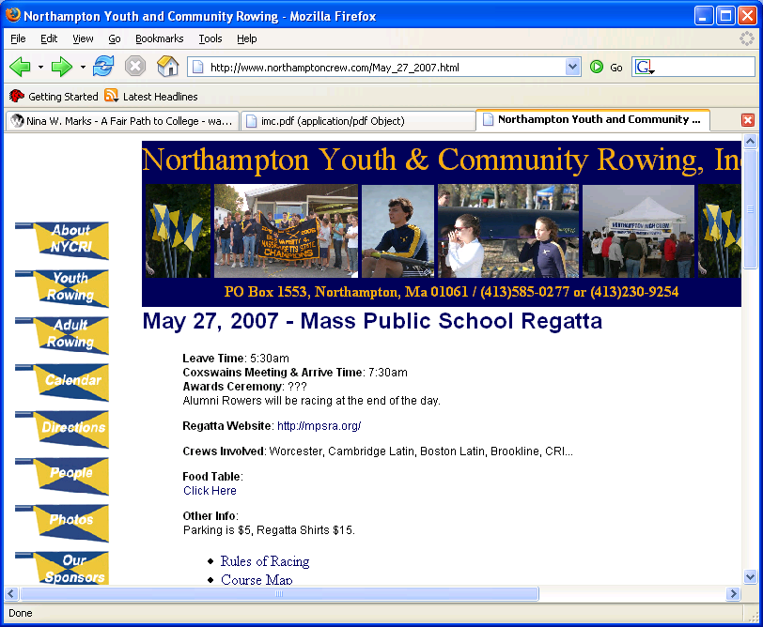
Web caches (proxy server)
Goal: satisfy client request without involving origin server
user sets browser: Web accesses via cache
browser sends all HTTP requests to cache
  object in cache: cache returns object
  else cache requests object from origin server, then returns object to client
origin
server
Proxy
server
HTTP request
HTTP request
client
HTTP response
HTTP response
HTTP request
HTTP response
client
origin
server

Slide 37
More about Web caching
cache acts as both client and server
typically cache is installed by ISP (university, company, residential ISP)
Why Web caching?
reduce response time for client request
reduce traffic on an institution’s access link.
Internet dense with caches: enables “poor” content providers to effectively deliver content (but so does P2P file sharing)

Slide 38
Caching example
origin
servers
Assumptions
average object size = 100,000 bits
avg. request rate from institution’s browsers to origin servers = 15/sec
delay from institutional router to any origin server and back to router = 2 sec
Consequences
utilization on LAN = 15%
utilization on access link = 100%
total delay = Internet delay + access delay + LAN delay
= 2 sec + minutes + milliseconds
public
Internet
1.5 Mbps
access link
institutional
network
10 Mbps LAN
institutional
cache

Slide 39
Caching example (cont)
origin
servers
possible solution
increase bandwidth of access link to, say, 10 Mbps
consequence
utilization on LAN = 15%
utilization on access link = 15%
Total delay = Internet delay + access delay + LAN delay
= 2 sec + msecs + msecs
often a costly upgrade
public
Internet
10 Mbps
access link
institutional
network
10 Mbps LAN
institutional
cache

Slide 40
Caching example (cont)
origin
servers
possible solution: install cache
suppose hit rate is 0.4
consequence
40% requests will be satisfied almost immediately
60% requests satisfied by origin server
utilization of access link reduced to 60%, resulting in negligible delays (say 10 msec)
total avg delay = Internet delay + access delay + LAN delay = .6*(2.01) secs + .4*milliseconds < 1.4 secs
public
Internet
1.5 Mbps
access link
institutional
network
10 Mbps LAN
institutional
cache

Slide 41
Conditional GET
cache
server
Goal: don’t send object if cache has up-to-date cached version
cache: specify date of cached copy in HTTP request
  If-modified-since: <date>
server: response contains no object if cached copy is up-to-date:
  HTTP/1.0 304 Not Modified
HTTP request msg
If-modified-since: <date>
object
not
modified
HTTP response
HTTP/1.0
304 Not Modified
HTTP request msg
If-modified-since: <date>
object
modified
HTTP response
HTTP/1.0 200 OK
<data>

